Slide 1

PC builder web application
Guided By: Professor Henry Wong
Deliverable 1
Team Name: Dice
Team member:
Kevin Song
Siyuan He
Xu Zhang
Haimiao Yu
Chhanna Gaha
Sichao Liu

Slide 2
Introduction
Hardware always plays a critical role in the research and application areas in computer science. There are plenty of manufactures providing highly customized products in the market to serve different levels of requirements. However, even today with the modernized online shopping platform, finding the most suitable hardware is still not very straightforward and most of time time-consuming for customers especially those ones without deep knowledge in this area such as students.
Many computer software students may struggle to find right pc hardware that match's their field of study. Our application will help them filter out the correct hardware.
This web application will not just help students, it will also benefit any client that wish to customize their PC.

Slide 3
Problems
Example Persona: Wendy is a student at Georgia tech. She majored in computer science and has very good programming skills. While taking a parallel computing class, her professor asks students to have a laptop with at least 16 GB of RAM. She finds that her 4 GB laptop runs hot and won’t get the job done.
The main issue with many web hardware pickers is that they are likely to introduce budget pc hardware which may be enough for daily tasks but not adequate for use for more demanding work.
Also while performance is a major issue, many PC hardware websites do not offer any solution on cooling, which is sometimes a critical issue that can impact hardware life span.

Slide 4
Personas
Students
The web application will guide students in picking the right hardware parts for the field they study.
PC buyer
The website will have prebuilt PC configuration for clients who just want buy a PC directly.
PC builder
The web application will break down customizable options for PC enthusiasts.
Buyer & Seller
Client can buy & sell their PC though our website. Communication channel for chat.
General user
Search bar that can use to search items within web app.

Slide 5
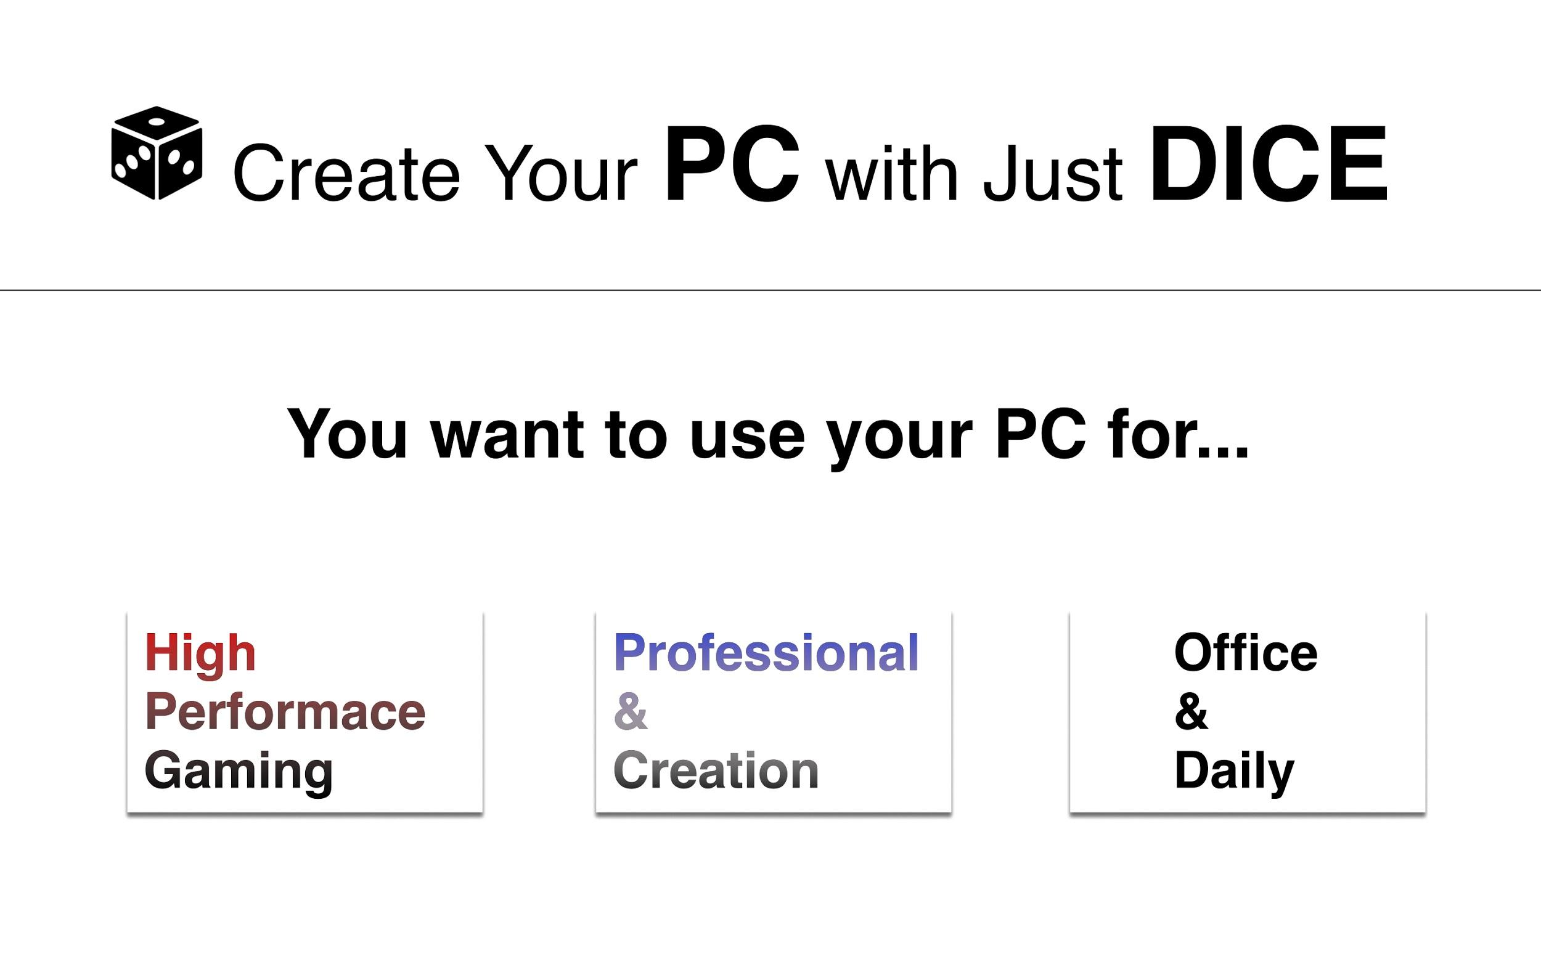
Our solution
Specialized hardware decision for different hardware seeker
Clear web design for smooth browsing
Easy communication with other builder to share the experience
Balance budget between performance and cooling hardware
Overall provides a web application to facilitate and guide customers to find hardware to meet their technical and financial requirement in a timely fashion.

Slide 6
Future ideal
A price match ability
An Advanced search bar that can provide more information

Slide 7
Technologies to be used
Frontend: ReactJS
Database: Google Firebase/MySQL
API: python
Process management: Miro

Slide 8
Thank You

